Slide 1
DATA ANALYSIS ON OLYMPICS
By MVVN SaiRam
11701975
A07

Slide 2
Introduction
The modern Olympic Games or Olympics are leading international sporting events featuring summer and winter sports competitions in which thousands of athletes from around the world participate in a variety of competitions. The Olympic Games are held every four years, with the Summer and Winter Games alternating by occurring every four years but two years apart
The first, second, and third-place finishers in each event receive Olympic medals: gold, silver, and bronze, respectively

Slide 3
Scope of Analysis
This project on Olympic Games Statistics of World provides the overall Statistics details of the Olympic Games held from the year 1868 to 2016.
The project has a dataset with more than 12k rows and 15 columns which are being processed using Excel. These help us to create various graphs for better visualization. The project uses pivot table, pivot chart and some formulas to analyse the data.

Slide 4
Source of Data used
The data set is being downloaded from the Kaggle Website and has been published by Kaggle. This dataset gives us an in-depth information about Olympic Games.
The link of the dataset is->http://www.kaggle.com/heesoo37/120years-of-olympic-history-atheles-and-results

Slide 5
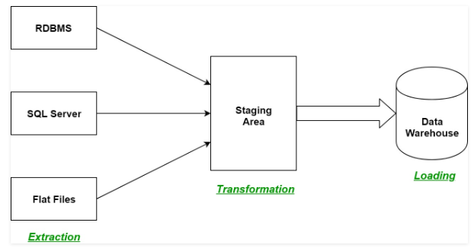
ETL Process
ETL is a process in Data Warehousing and it stands for Extract, Transform and Load. It is a process in which an ETL tool extracts the data from various data source systems, transforms it in the staging area and then finally, loads it into the Data Warehouse system.

Slide 6
Objectives of the Analysis
1.Analysis on Number of participants participated in Olympics games Country wise.
2.Analysis on participants categorized by Male and Female gender.
3.Analysis on number of Medals awarded in different sports from year 1868 to 2016
4.Analysis on Medals achieved by different Countries and comparing between them.
5.Analysis on partcipants based on their Age(Age<30,>30 and <50,Age >50).

Slide 7
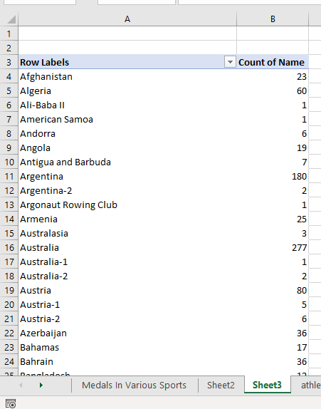
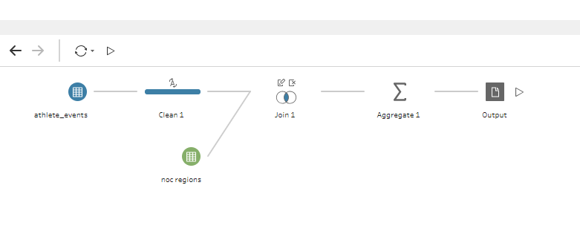
Objective 1
1.Analysis on Number of participants participated in Olympics games Country wise.

Slide 8
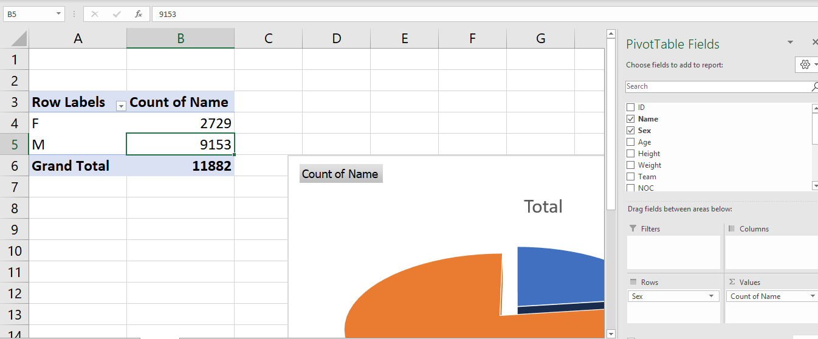
Objective2
2. Analysis on participants categorized by Male and Female gender.
Introduction:

Slide 9
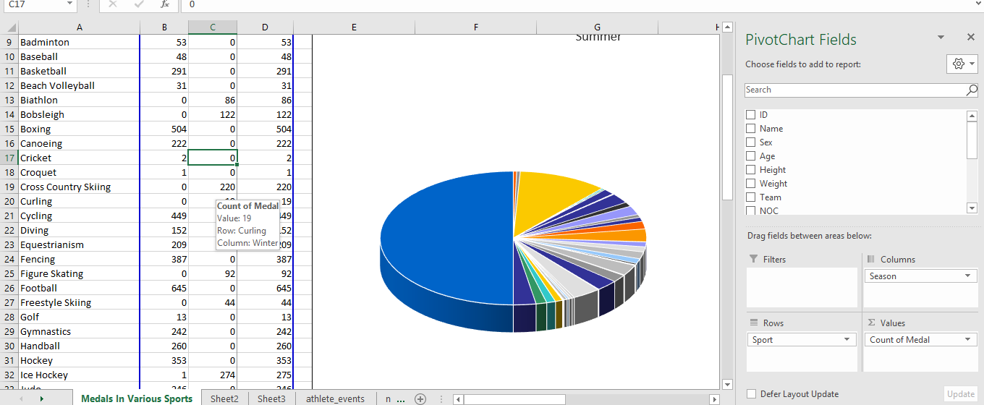
Objective 3
3. Analysis on number of Medals awarded in different sports from year 1868 to 2016

Slide 10
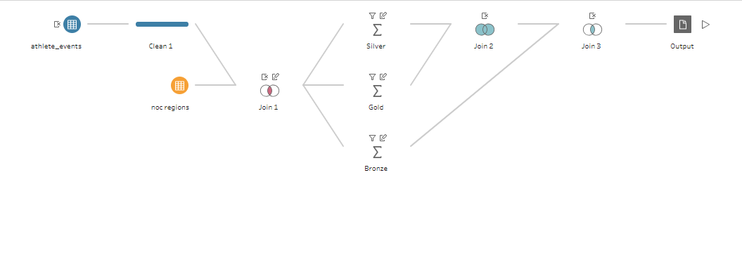
Objective 4
4. Analysis on Medals achieved by different Countries and comparing between them

Slide 11
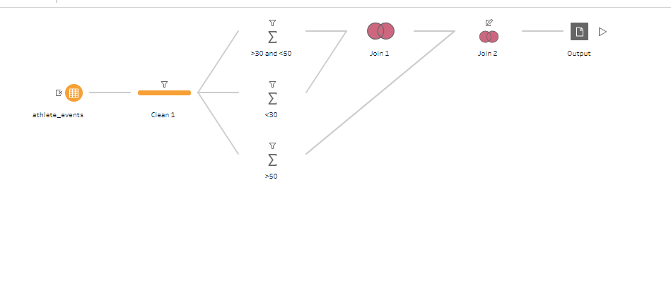
Objective 5
5. Analysis on partcipants based on their Age(Age<30,>30 and <50,Age >50).

